Slide 1

Lecture 1: C Programming in UNIX Environment
Dr. Amir Yavariabdi
amir.yavariabdi@bth.se
1

Slide 2
Supplementary Reading Material
In the next four lectures, we will be using the book
System Programming with C and Unix by Hoover, Adam (Addison-Wesley, Clemson University)
alongside the main reference book for the course.
While it is not the primary reference, it will serve as a supplementary resource.

Slide 3
Lectures
Date | Task | Time | Room
16/09/2024 | Lecture 1 | 15:10-16:00 16:10-17:00 | G340
17/09/2024 | Lecture 2 | 8:10-9:00 9:10-10:00 | C313A
18/09/2024 | Lecture 3 | 13:10-14:00 14:10-15:00 | G404
23/09/2024 | Lecture 4 | 8:10-9:00 9:10-10:00 | G404
25/09/2024 | Lab Q&A | 10:00-12:00 | J3118
02/10/2024 | Lab Q&A | 8:00-11:00 | C245 ALC
03/10/2024 | Assignment Q&A | 08:00-12:00 13:00-17:00 | J1270 ALC

Slide 4
Outline
Introduction to System and Application Software with C and Unix
Overview of Text Editors and Debuggers used in Unix
Review of C Programming:
Basic data types
Basic arithmetic operations
Conditionals (if-else)

Slide 5
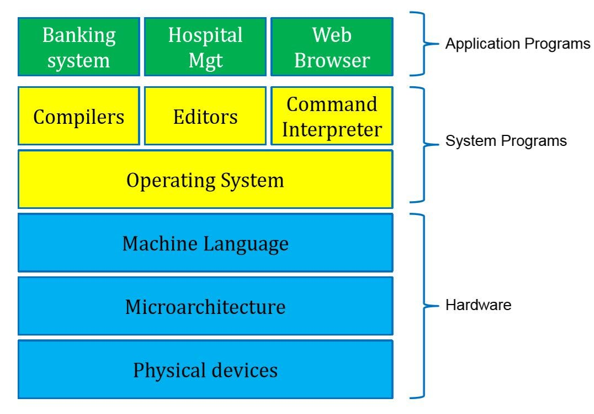
System Software
System software is a set of system programs that manage and control a computer's hardware and provide a platform for other software (i.e., application software) to function.
It serves as a bridge between the hardware and user applications, ensuring the system operates smoothly.
Examples of system software include operating systems (such as Windows, macOS, Linux), device drivers, utility programs, and system libraries.
These programs are typically written in low-level languages and are essential for tasks like managing memory, processing power, and hardware devices.
Machine Structure
Taken from: medium.com/@malviyav24/system-programming-8bf06f8af78c
Notes:
A kernel is a central component of an operating system that manages the operations of computers and hardware.

Slide 6
System Software vs. Application Software
System Software | Application Software
Used for operating computer hardware | Used by user to perform specific task
In general, the user does not interact with system software as it works in the background | In general, the user interacts with application software’s
Can run independently, it provides platforms for running application software’s | Application software's cannot run indecently as they cannot run without the presence of system software
Makes machine to do work | Makes system program to do work
Debugging is difficult | Debugging is not difficult
Some examples are operating system, compiler, debugger, assembler, driver, etc. | Some examples are word processors, web browsers, media player, video games, etc.

Slide 7
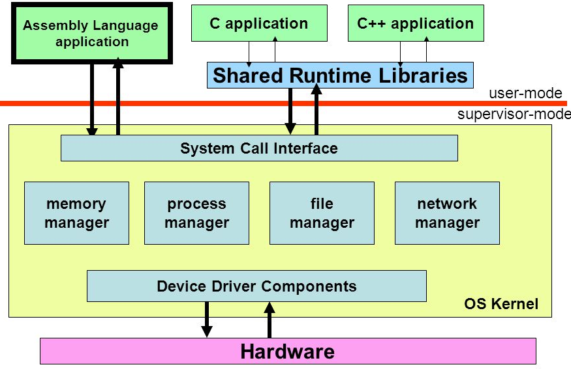
Elements of System Programming
Operating Systems:
Kernel Development: Core part of an OS that manages system resources and communication between hardware and software.
System Calls: Functions provided by the OS to allow user/application programs to request services and resources from the kernel.
There are 5 types of system calls:
Process control
File management
Device management
Information maintenance
communication
Notes:
The kernel is also responsible for preventing and mitigating conflicts between different processes.
System Calls enable user-level applications to request services and resources managed by the OS, such as hardware access, process management, and file handling. These calls act as a bridge between user applications and the core functionalities of the operating system, ensuring controlled and secure access to system resources.

Slide 8
Elements of System Programming
Device Drivers:
Hardware Interface: Software that enables the operating system to communicate with hardware devices.
Development: Writing and maintaining code that controls hardware components.
Compilers:
Code Translation: Converts high-level programming languages into machine code.
Optimization: Improves code efficiency and performance during the translation process.

Slide 9
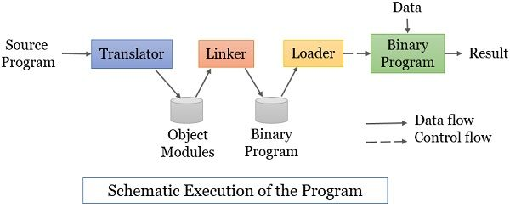
Elements of System Programming
Loaders and Linkers:
Linker: Combines various program modules into a single executable.
A linker combines the target program generated by the language translator with all the external references mentioned in the program.
Loader: Loads programs into memory for execution.
A loader is a system program that loads or places the machine language program or the binary program in the main memory for its execution. The linker generates this binary program and places it on the hard disk. The loader locates this executable binary program from the hard disk and loads it on the main memory.
Notes:
https://binaryterms.com/linker-and-loader-in-system-programming.html

Slide 10
Elements of System Programming
Debuggers:
Error Detection: Tools that help identify and fix bugs in software.
Runtime Analysis: Allows developers to inspect the state of a program during execution.
System Libraries:
Collections of pre-written code that provide common functions.
Shell Scripts:
A text file containing a series of commands, written in a shell programming language (like Bash or Zsh), that are executed in sequence by the shell.

Slide 11
Why Unix in Programming
Unix is crucial due to its powerful tools, robust scripting capabilities, and foundational influence on modern operating systems like Linux.
Its comprehensive programming interface and system calls enable direct kernel interaction, making it ideal for developing and managing software.
Unlike Windows, which has a closed design and limited transparency, Unix, specifically Linux, is open source and completely modular, allowing any system component to be studied, swapped, or modified.
This flexibility and openness make Unix an attractive choice for programmers.

Slide 12
Why C in Programming
C is the preferred language for system and application software because it is closest to the hardware, offering minimal abstraction and allowing direct memory access through pointers.
This proximity to hardware ensures that C code translates efficiently into machine code, resulting in faster execution.
Historically, both Unix and Linux kernels were developed in C, and most system software, including device drivers, is written in C.
Learning C is essential for developing software that interacts directly with hardware.

Slide 13
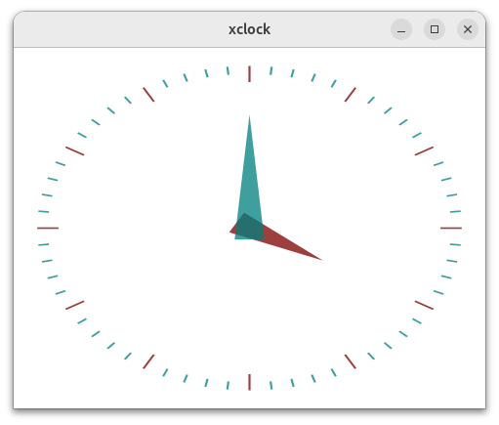
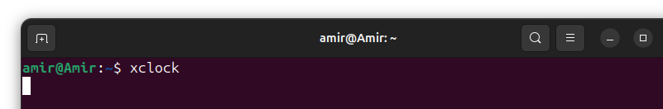
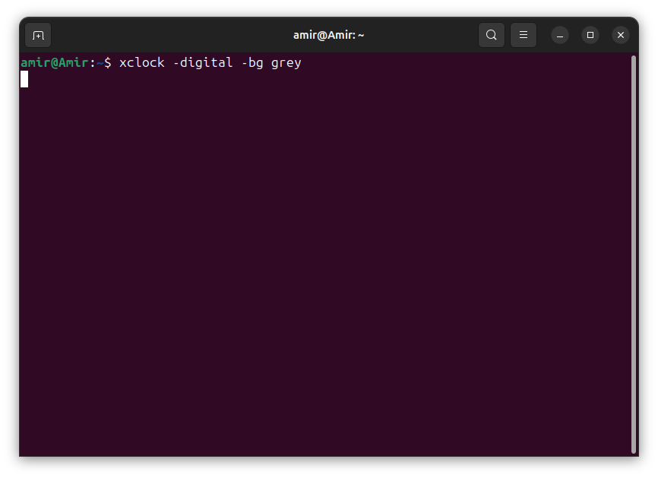
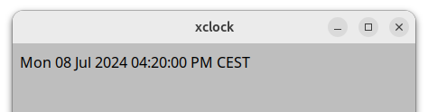
Tools in Unix
Three tools are essential for programmers in Unix to efficiently develop, debug, and maintain software:
Shell:
Provides an interface for users to interact with the operating system by typing commands.
Facilitates the automation of repetitive tasks through shell scripts.
Allows direct access to system functions for managing files, running programs, and configuring settings.

Slide 14
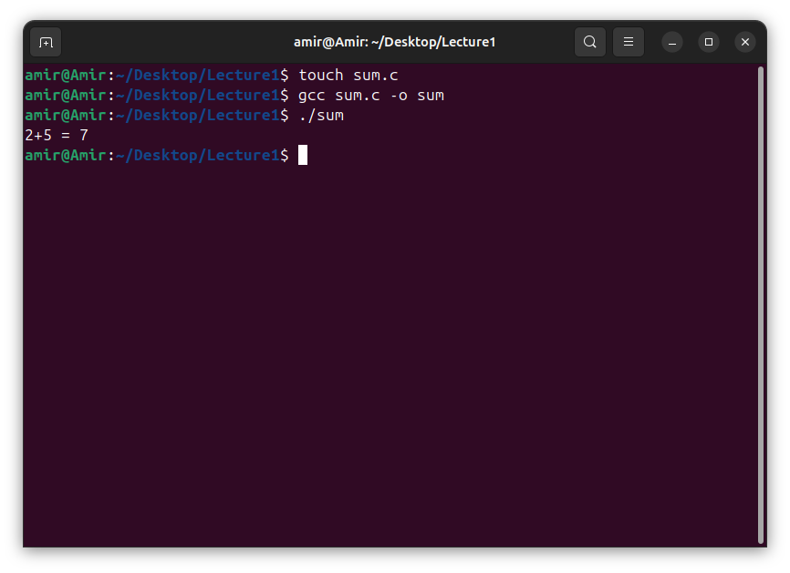
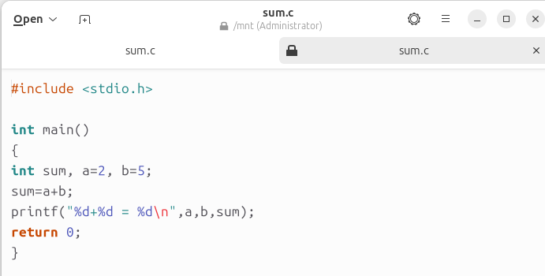
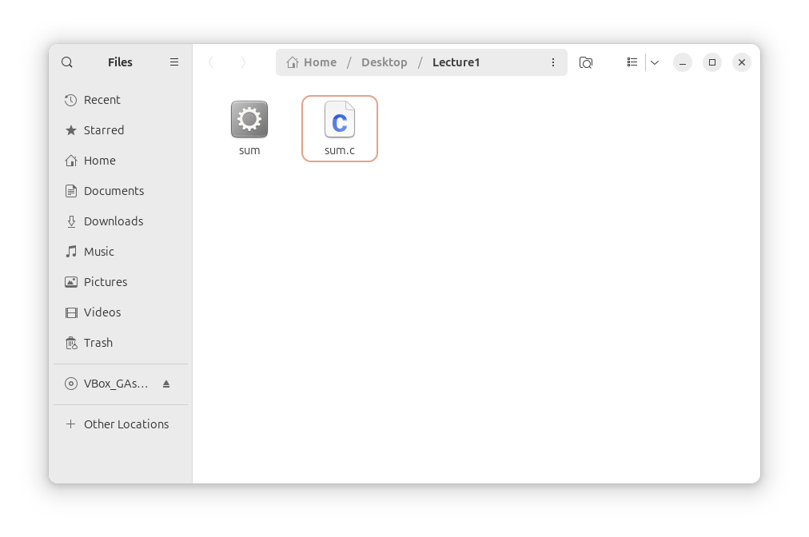
Tools in Unix
Three tools are essential for programmers in Unix to efficiently develop, debug, and maintain system software:
Text Editor:
Code Writing and Editing: A tool for writing and modifying source code and configuration files.
Generate empty C file
Source

Slide 15
Tools in Unix
Three tools are essential for programmers in Unix to efficiently develop, debug, and maintain system software:
Compiler, Executer, and Debugger:
A compiler is a program that translates high-level source code written in programming languages (like C, C++, or Fortran) into machine code (binary code) that the computer’s processor can execute. In Unix systems, the most commonly used compiler is GCC.
Compiler Functions:
Translation: Converts source code into machine code or an intermediate code.
Optimization: Improves the performance of the generated machine code.
Error Checking: Identifies syntax and semantic errors in the source code.
Binary
Compiler
Source
Output binary file name
Output
Output binary file name

Slide 16
Tools in Unix
Three tools are essential for programmers in Unix to efficiently develop, debug, and maintain system software:
Compiler, Executer, and Debugger:
An executor (or execution environment) in Unix refers to the system's ability to run compiled programs.
This typically involves loading the executable code into memory and running it on the CPU.
Binary
Source
Compiler
Output
Executer
Output binary file name
Execute binary

Slide 17
Tools in Unix
Three tools are essential for programmers in Unix to efficiently develop, debug, and maintain system software:
Compiler, Executer, and Debugger:
A debugger is a tool that allows developers to inspect and control the execution of a program to identify and fix bugs or unexpected behaviors.
Debuggers provide capabilities like setting breakpoints, stepping through code, inspecting variables, and examining the call stack.
In Unix, the most commonly used debugger is GDB (GNU Debugger).
Compile the C program using GCC with debugging information included by using the -g flag:
gcc -g -o sum sum.c
-g: Includes debugging information in the compiled executable.
-o sum: Specifies the output executable file name as sum.

Slide 18
Review of C Programming: Data Types
In C, data types are categorized into several groups based on their functionality and usage.
Basic Data Types in C:
char: store character symbols. Typically, 1 byte is used to store characters.
int: store a number without a decimal point. Typically, 4 bytes is used to store integers.
short: Typically, 2 bytes, used for smaller integer values.
long: Typically, 4 (on 32-bit systems) or 8 bytes (on 64-bit systems), used for larger integer values.
long long: Typically, 8 bytes, used for even larger integer values.
float: store a real number that has a decimal place. A float has 7 decimal digits of precision and occupies 4 bytes. It is used to store single-precision floating-point numbers.
double: store a real number that has a decimal place. Typically, 8 bytes, used to store double-precision floating-point numbers.
long double: Typically, 8, 12, or 16 bytes, used to store extended-precision floating-point numbers.

Slide 19
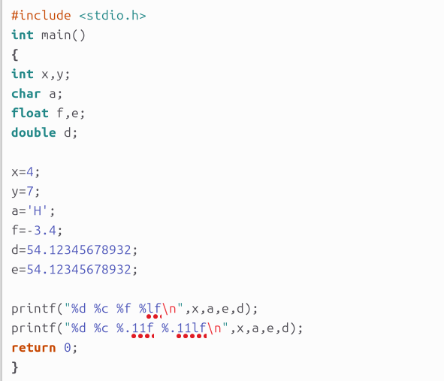
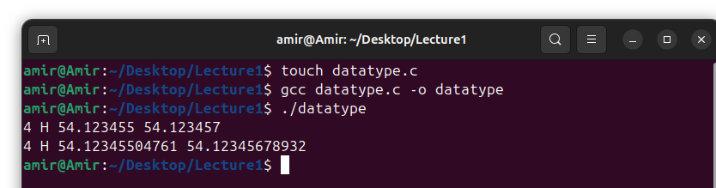
Example 1: Basic Data Types:

Slide 20
Example 1: Issue with float (single-precision)
The float variable has been rounded downward in the last displayed digit, while the double variable has correctly been rounded upward.
The float has simply run out of precision.

Slide 21
Example 1: Issue with float (single-precision)
The float variable has been rounded downward in the last displayed digit, while the double variable has correctly been rounded upward.
The float has simply run out of precision.
The precision issue can be seen in the second line of output, where both variables are forced to print to 11 decimal places.
The double variable has the correct value, but the float has erroneous values in the latter digits.

Slide 22
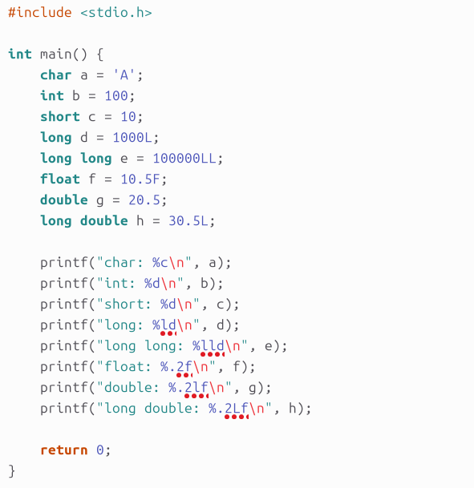
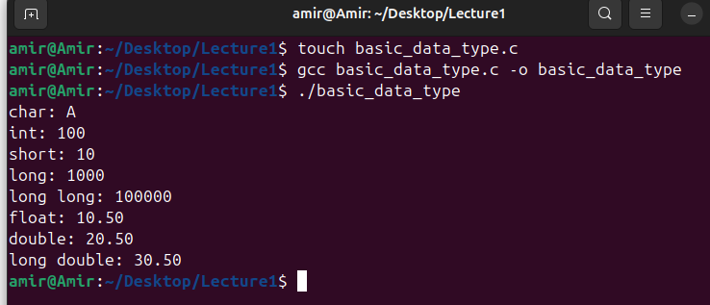
Example 2: Basic Data Types

Slide 23
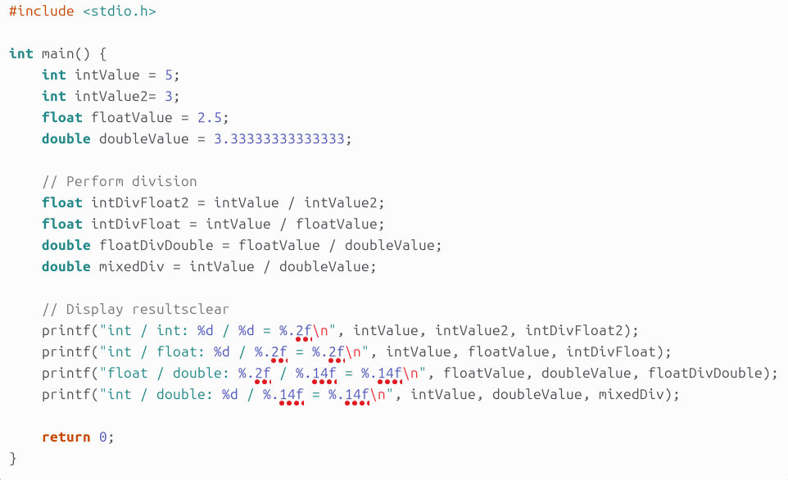
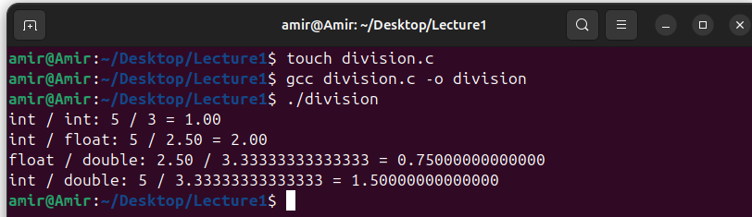
Example 3: Division with Basic Data Types

Slide 24
Example 3: Issue
The issue with int/int division in C is that when you divide two integers, the result is an integer, and any fractional part is discarded.
To obtain a floating-point result, we must explicitly convert one of the integers to a float or double before performing the division.

Slide 25
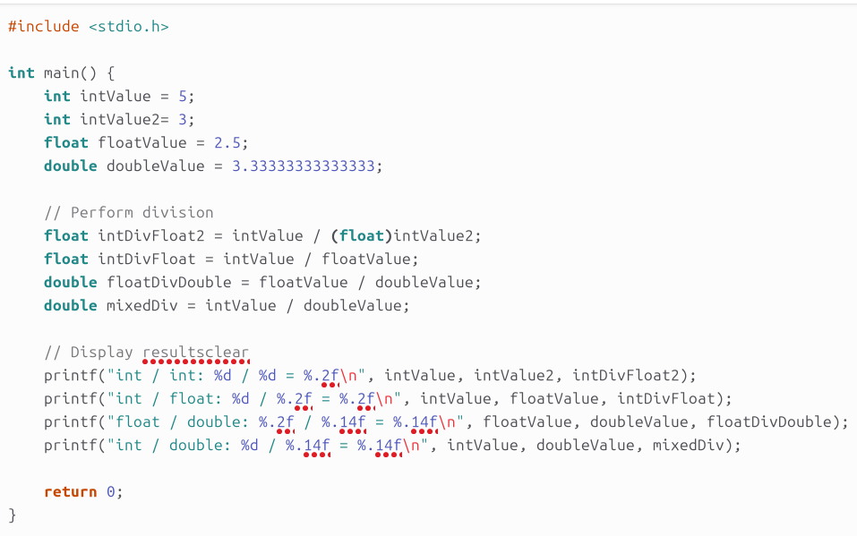
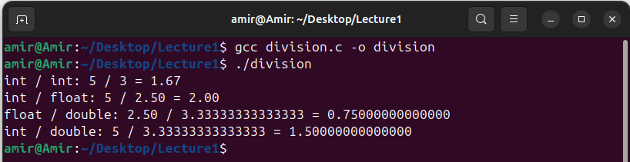
Example 3: Issue Solved

Slide 26
Review of C Programming: Data Types
In C, data types are categorized into several groups based on their functionality and usage.
Derived Data Types in C:
arrays: An array is a collection of elements of the same type stored in contiguous memory locations.
pointers: A pointer is a variable that stores the address of another variable.
structures (struct): A structure is a user-defined data type that allows grouping of variables of different types.
unions (union): A union is a user-defined data type similar to a structure, but with a key difference: all members share the same memory location. It can help to save memory.
enumerations (enum): enum creates a list of named values. Instead of using plain numbers, we can use descriptive names to make our code more readable and easier to understand. For example, instead of using 0 or 1 to represent days of the week, you can use SUNDAY and MONDAY.

Slide 27
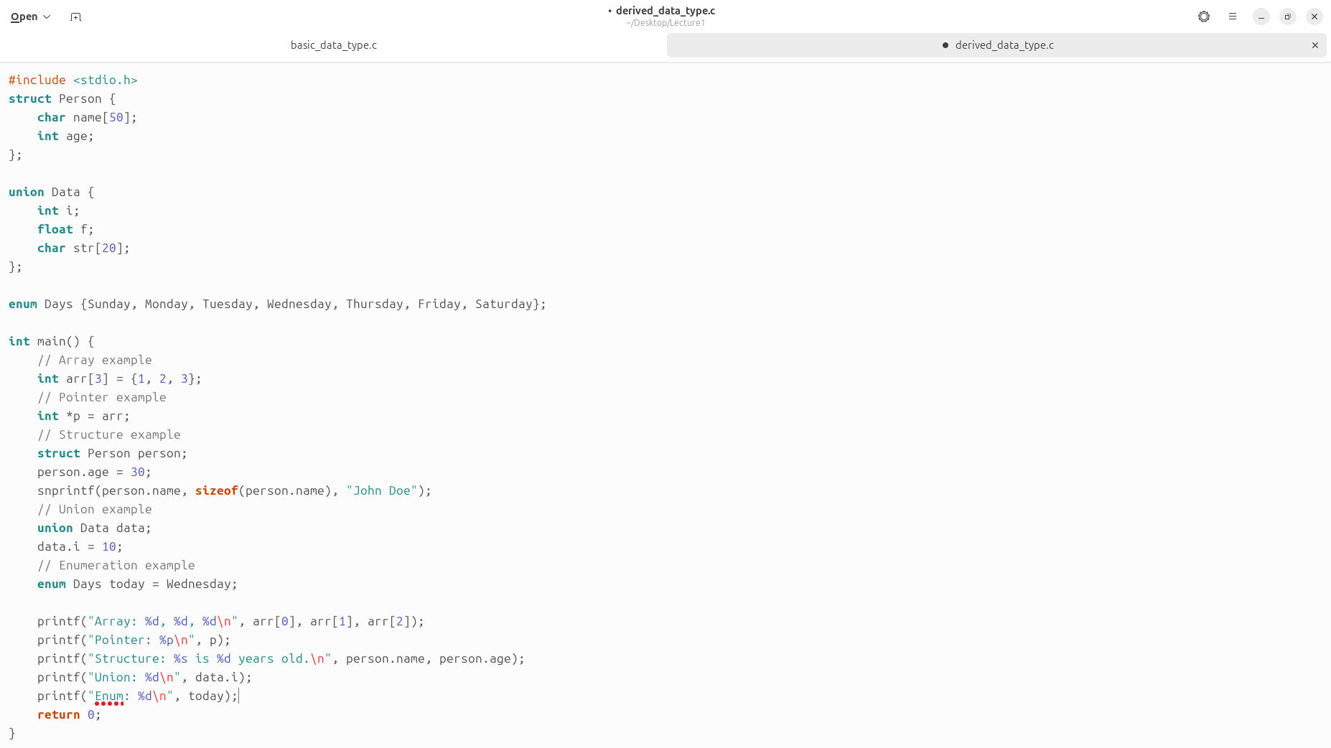
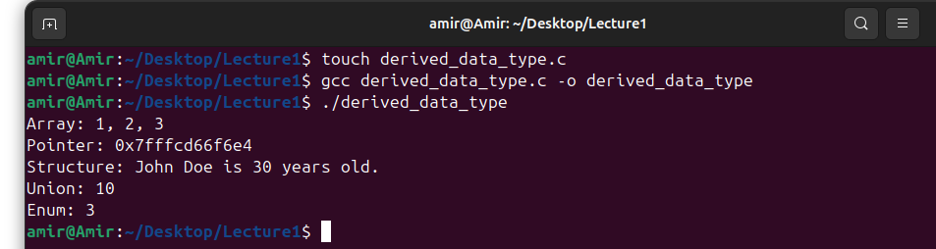
Example 4: Derived Data Types

Slide 28
Example 4: Explanation
The program starts by including the standard input-output library stdio.h. This allows the use of functions like printf and scanf for input and output operations.
Defining a Structure:
The program defines a structure Person with two members:
char name[50]: an array of 50 characters to store the person's name.
int age: an integer to store the person's age.
Defining a Union:
The program defines a union Data with three members:
int i: an integer.
float f: a floating-point number.
char str[20]: an array of 20 characters to store a string.
A union allows storing different data types in the same memory location, but only one member can be used at a time.

Slide 29
Example 4: Explanation
Defining an Enumeration:
The program defines an enumeration Days with values representing the days of the week:
Sunday, Monday, Tuesday, Wednesday, Thursday, Friday, Saturday.
Enumerations provide a way to assign names to integral constants, making the code more readable.
Inside the main Function:
The program declares an integer array arr with three elements and initializes it.
The program declares a pointer p that points to the first element of the array arr.
The program declares a variable person of type struct Person.
It sets the age member of person to 30.
It assigns the string "John Doe" to the name member of person using snprintf.
snprintf: Used to safely format and copy the string into the destination buffer.
sizeof(person.name): Ensures the string fits within the bounds of the name array, preventing buffer overflow.

Slide 30
Example 4: Explanation
Inside the main Function:
The program declares a variable data of type union Data.
It sets the integer member i of data to 10.
The program prints the elements of the array arr using printf.
It prints the value pointed to by the pointer p, which is the first element of the array.
It prints the name and age of the person structure.
It prints the value of the i member of the data union.
It prints the integer value corresponding to today, which represents Wednesday.

Slide 31
Syntax of scanf
The scanf function expects a pointer as its argument for input variables.
For integers and other primitive types, you need to provide the address using the & operator.
scanf("%d", &age);
For strings, since the array name already represents the address of the first element, we do not need to use the & operator.
scanf("%s", name);

Slide 32
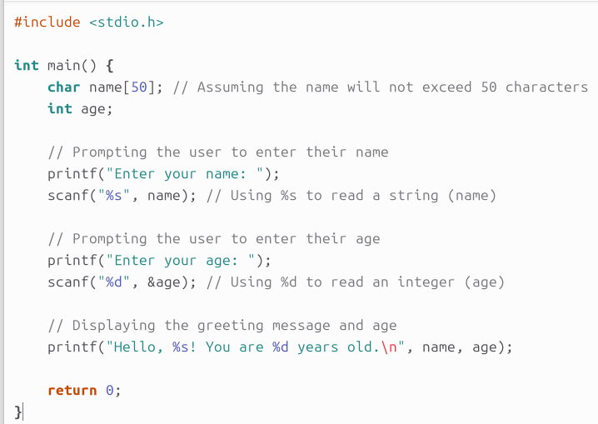
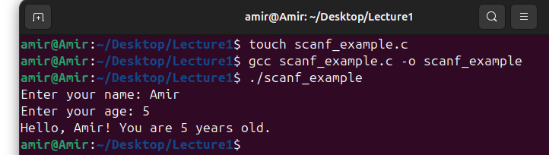
Example 5: Scanf
Write a C program that asks the user to enter their name and age, then prints a greeting message followed by their age in years.

Slide 33
Example 5: Explanation
The program starts by including the standard input-output library stdio.h.
Inside the main function:
It defines an array name of type char to store the user's name, assuming a maximum length of 50 characters.
It introduces an integer variable age to store the user's age.
The program asks the user to enter their name using printf.
It reads the user's input for the name using scanf with the %s format specifier, which reads a string until whitespace is encountered.
Next, the program asks the user to enter their age using printf.
It reads the user's input for the age using scanf with the %d format specifier, which reads an integer.
Finally, the program displays a greeting message using printf, including the user's name and age.

Slide 34
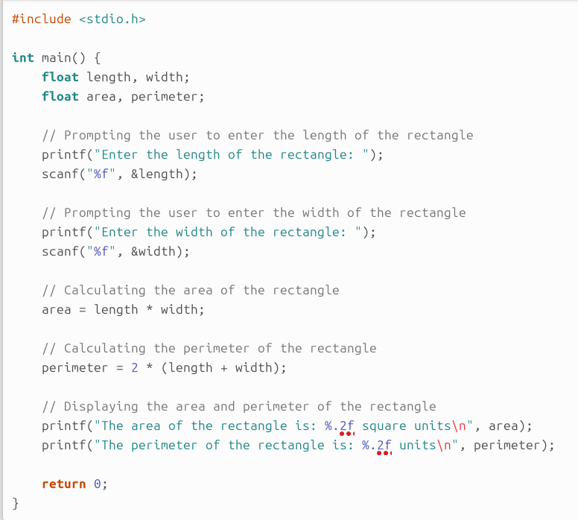
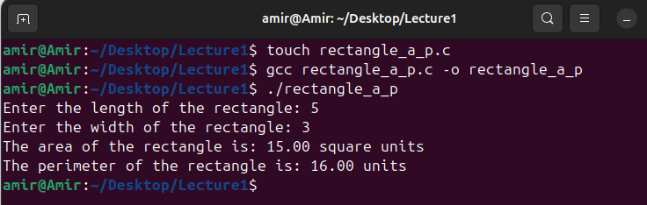
Example 6: Scanf
Write a C program that asks the user to enter the length and width of a rectangle, calculates the area and perimeter of the rectangle, and then prints these values.

Slide 35
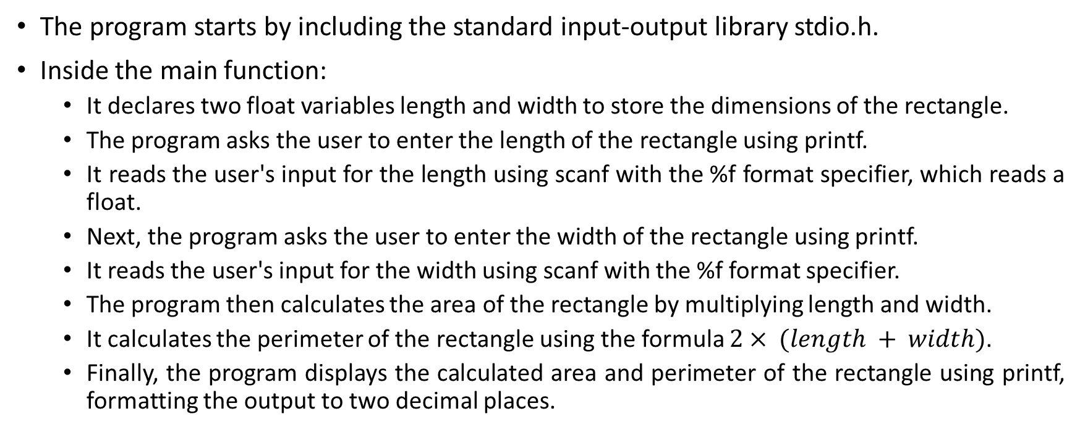
Example 6: Explanation
The program starts by including the standard input-output library stdio.h.
Inside the main function:
It declares two float variables length and width to store the dimensions of the rectangle.
The program asks the user to enter the length of the rectangle using printf.
It reads the user's input for the length using scanf with the %f format specifier, which reads a float.
Next, the program asks the user to enter the width of the rectangle using printf.
It reads the user's input for the width using scanf with the %f format specifier.
The program then calculates the area of the rectangle by multiplying length and width.
It calculates the perimeter of the rectangle using the formula $2× (length + width)$.
Finally, the program displays the calculated area and perimeter of the rectangle using printf, formatting the output to two decimal places.

Slide 36
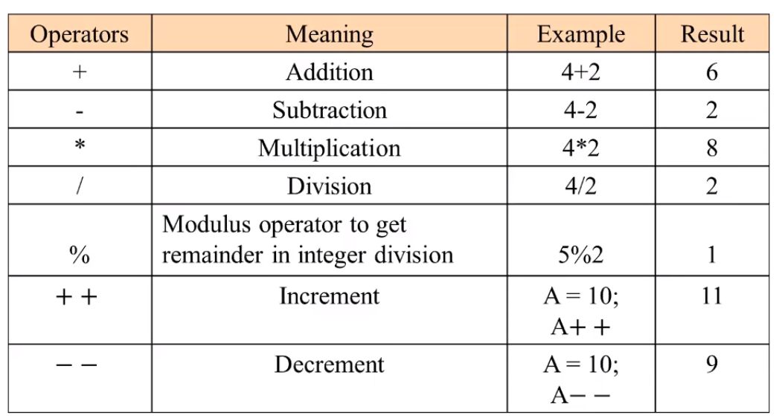
Arithmetic Operations in C

Slide 37
Operator precedence in C
Operator precedence:
Some arithmetic operators act before others (i.e., multiplication before addition)
Use parenthesis when needed
Example: Find the average of three variables a, b and c
Do not use: a + b + c / 3
Use: (a + b + c ) / 3 and perimeter of the rectangle using printf, formatting the output to two decimal places.
Operator(s) | Operation(s) | Order of evaluation
() | Parentheses | Evaluated first. If the parentheses are nested, the expression in the innermost pair is evaluated first. If there are several pairs of parentheses on the same level, they are evaluated left to right.
*, /, or % | Multiplication, Division, Modulus | Evaluated second. If there are several, they are evaluated left to right.
+ or - | Addition, Subtraction | Evaluated last. If there are several, they are evaluated left to right.

Slide 38
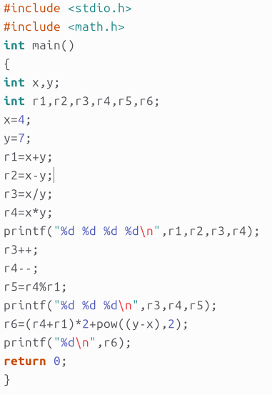
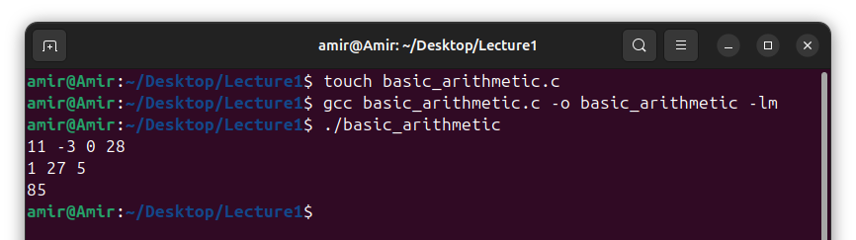
Example 7: Operations in C
The -lm flag tells the linker to include the math library (libm.so or libm.a) in this process.
Without the -lm flag, the linker will not be able to find the definitions of the mathematical functions, resulting in undefined reference errors.
For non-standard or third-party libraries, we might need to include specific flags during the linking stage. These flags typically start with -l followed by the library name. #include <pcre.h> Compile with: gcc program.c -o program -lpcre

Slide 39
Equality, Relational, Logical, and Ternary Operators
Operator | Meaning
< | Less than
> | Greater than
<= | Less than or equal to
>= | Greater than or equal to
== | Equal to
!= | Not equal to
Logical Operator | Meaning
&& | Logical AND. True only if all operands are true
|| | Logical OR. True only if either one operand is true
! | Logical NOT. True only if the operand is 0
Ternary Operator | Meaning
?: | Ternary or conditional operator

Slide 40
Control Structures
All programs written in terms of 3 control structures
Sequence structures: Built into C. Programs executed sequentially by default
Selection structures: C has three types: if, if...else, and switch
Repetition structures: C has three types: while, do...while and for
Selection structure:
Used to choose among alternative courses of action
Pseudocode:
If student’s grade is greater than or equal to 60 Print “Passed”
If condition true:
Print statement executed and program goes on to next statement
If false, print statement is ignored and the program goes onto the next statement

Slide 41
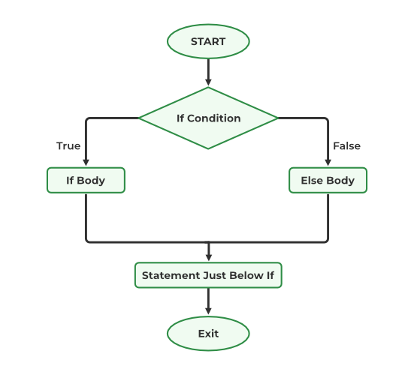
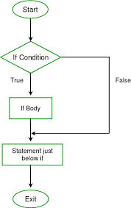
The if-else Statement
if only performs an action if the condition is true
if...else specifies an action to be performed both when the condition is true and when it is false.

Slide 42
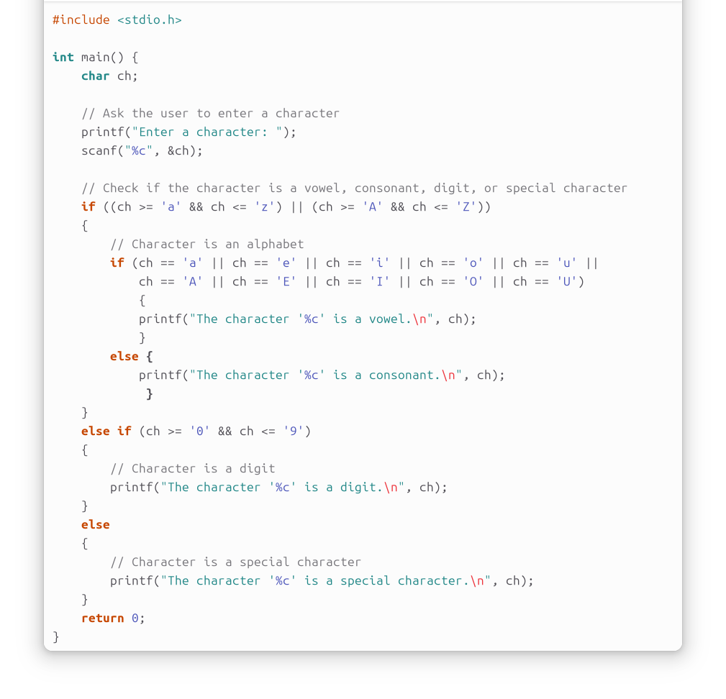
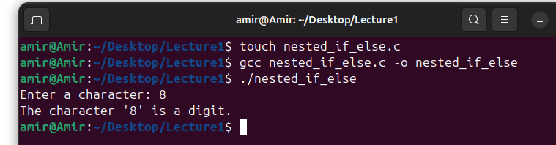
Example 8: if-else in C
Write a C program that asks the user to enter a character. The program should then determine whether the entered character is a vowel (a, e, i, o, u), a consonant, a digit (0-9), or a special character. Use nested if-else statements to implement the logic.
The OR operator
The AND operator

Slide 43
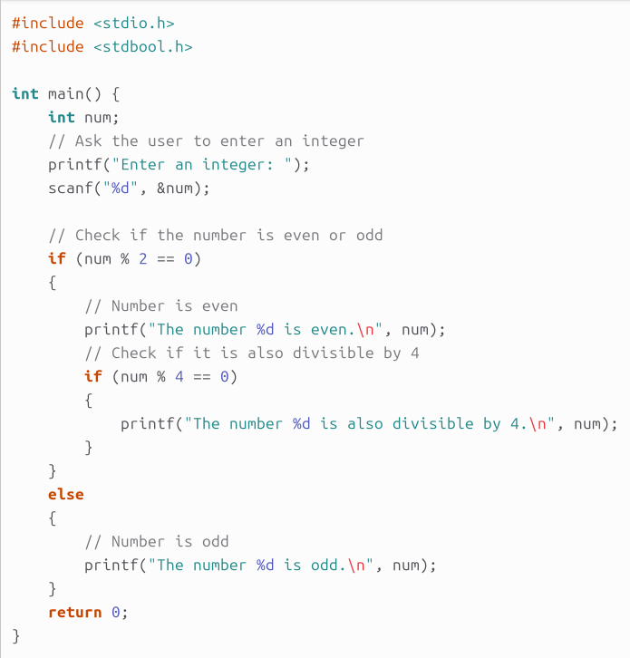
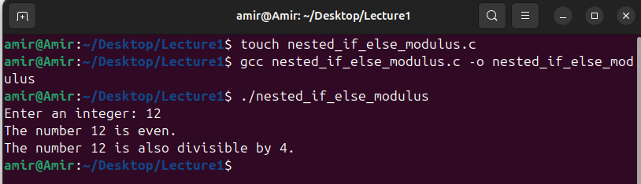
Example 9: if-else in C
Write a C program that asks the user to enter an integer. The program should determine whether the entered integer is even or odd. If the number is even, check if it is also divisible by 4. Use nested if-else statements and the modulus operator to implement the logic.

Slide 44
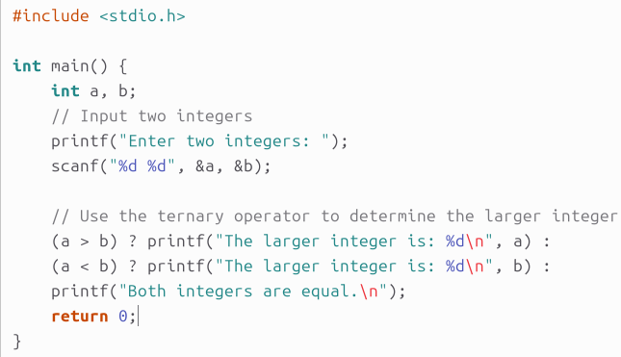

Example 10: Ternary in C
Write a C program that takes two integers as input and uses the ternary operator to determine and print the larger of the two integers. If both integers are equal, print a message indicating they are equal.

Slide 45
Thank you for listening

